Slide 1
G O D I S T R I N I T Y

Slide 2
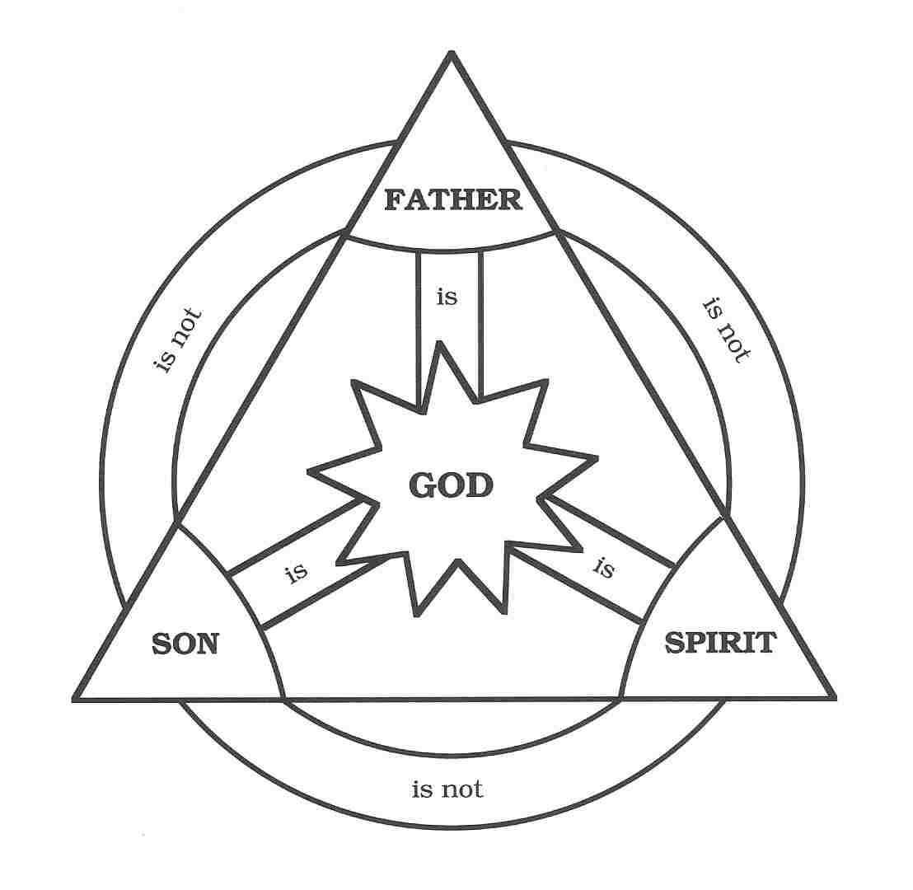
GOD IS TRINITY

Slide 3
There is one God – God is ONE
GOD IS TRINITY
Who foretold this long ago, who declared it from the distant past? Was it not I, the Lord? And there is no God apart from me, a righteous God and a Saviour; there is none but me. Turn to me and be saved … for I am God and there is no other Isaiah 45:21-22

Slide 4
There is one God – God is ONE
GOD IS TRINITY
You were shown these things so that you might know that the Lord is God; beside him there is no other. Deut 4:35
Hear O Israel: the Lord our God, the Lord is ONE. Deut 6:4

Slide 5
There is one God – God is ONE
GOD IS TRINITY
You believe that there is one God. Good! Even the demons believe that – and shudder. James 2:19
We know that an idol is nothing at all in the world and that there is no God but one. 1 Cor 8:4

Slide 6
Three are God – One God, three ‘persons’.
GOD IS TRINITY
God the Father
Is he not your father, your Creator, who made you and formed you? Deut 32:6
Yet for us there is but one God, the Father, from whom all things came 1 Cor 8:6
Matthew 6:26-30; John 17:3;
Lord’s prayer …

Slide 7
Three are God – One God, three ‘persons’.
GOD IS TRINITY
God the Son
Jesus … who, being in very nature God, did not consider equality with God something to be grasped, but made himself nothing Phil 2:6

Slide 8
Three are God – One God, three ‘persons’.
GOD IS TRINITY
God the Son
In the beginning was the Word, and the Word was with God, and the Word was God. He was with God in the beginning.
John 1:1-2

Slide 9
Three are God – One God, three ‘persons’.
GOD IS TRINITY
God the Son
In the past God spoke to our forefathers through the prophets at many times and in various ways, but in these last days he has spoken to us by the Son … the radiance of God’s glory and the exact representation of his being.
Hebrews 1:1-3

Slide 10
Three are God – One God, three ‘persons’.
GOD IS TRINITY
God the Son
John 8:58
John 10:33
Mark 2:8-10
Matthew 25:31
Colossians 2:9
Titus 2:13

Slide 11
Three are God – One God, three ‘persons’.
GOD IS TRINITY
God the Holy Spirit
Lied to the Holy Spirit … lied to God
Acts 5:3-4
And I will ask the Father, and he will give you another Counsellor to be with you forever – the Spirit of truth.
John 14:16-17

Slide 12
The Athanasian Creed
GOD IS TRINITY
We worship one God in Trinity, And Trinity in unity
Neither confusing the persons,
nor dividing the nature of God.
For there is one person of the Father,
another of the Son and another of the Holy Spirit. But the Godhead of the Father and of the Son and of the Holy Spirit is all one –
The glory equal, the majesty co-eternal.
What the Father is, so is the Son, and so is the Holy Spirit. Amen.

Slide 13
Threeness
GOD IS TRINITY
The Grace – 2 Cor 13:14
The Great Commission – Matthew 28:19
Jesus’ baptism – Matthew 3:13-17

Slide 14
G O D I S T R I N I T Y

