Slide 1
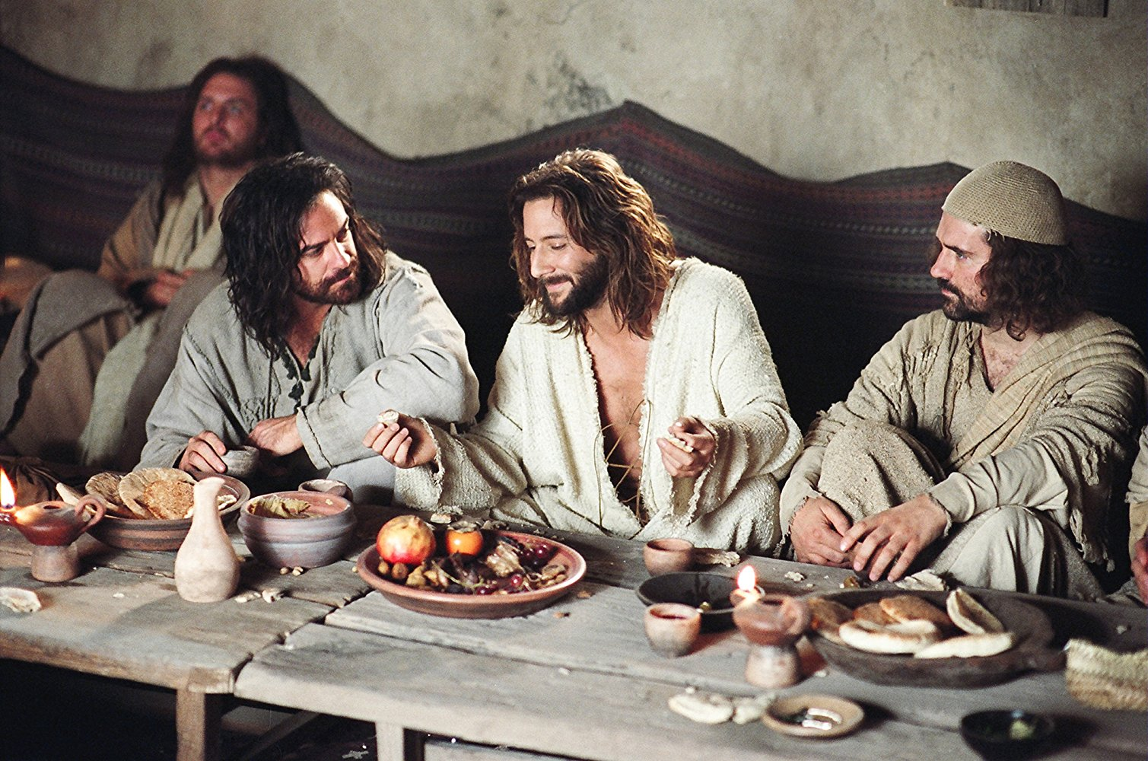
New Year, New Vision
Looking In
John 13:34

Slide 2
A new command I give you: love one another.
As I have loved you, so you must love one another.
John 13:34

Slide 3
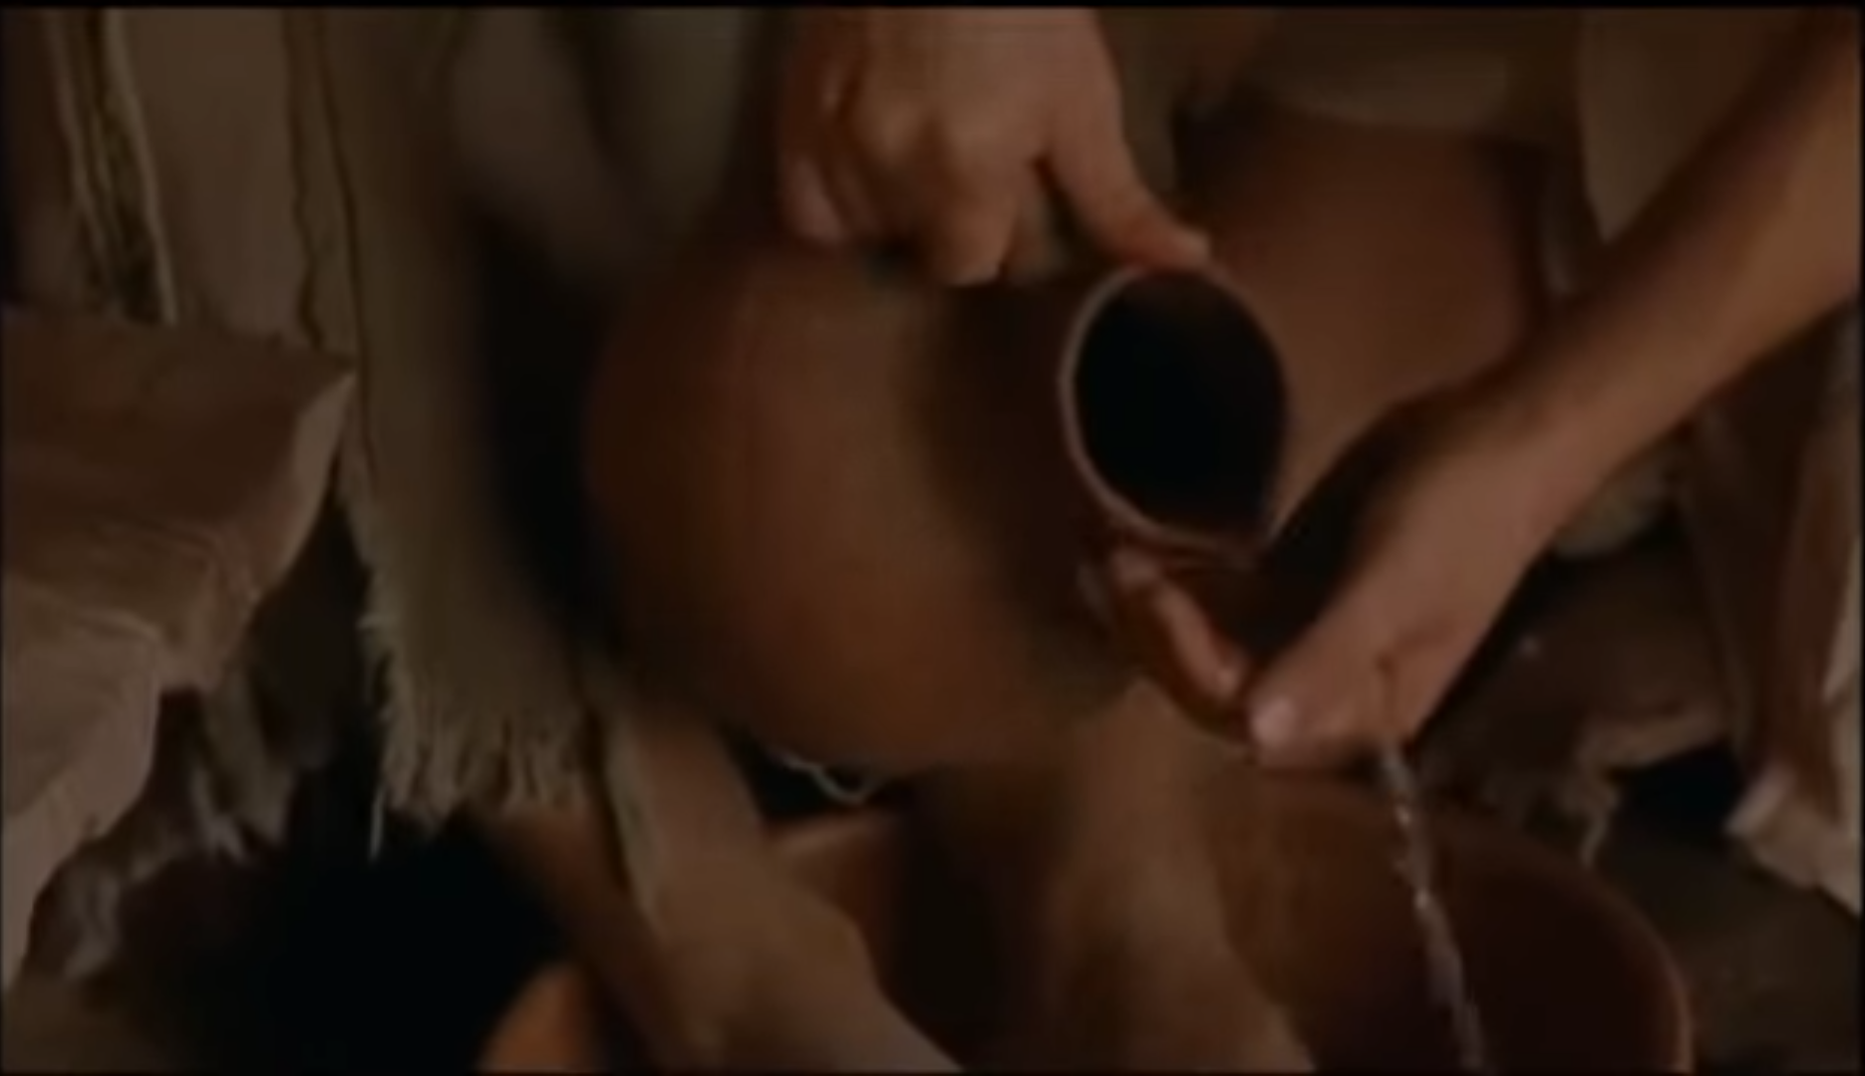

Slide 4
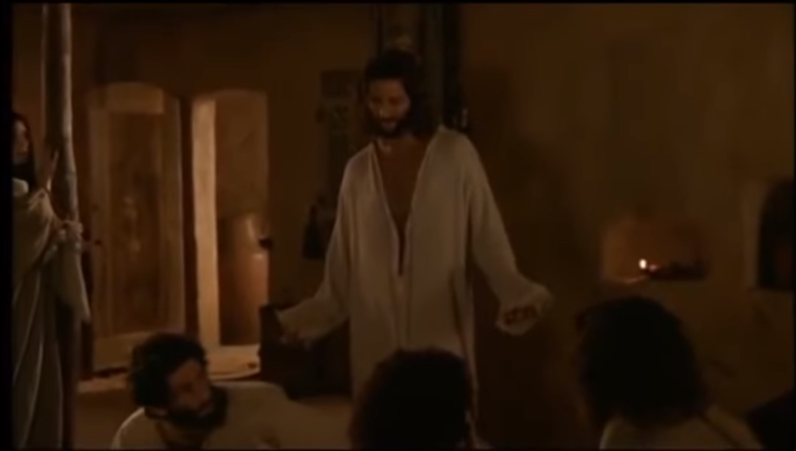
My children, I will be with you only a little longer.
John 13:33a

Slide 5
A new command I give you: love one another.
As I have loved you, so you must love one another.
Do not seek revenge or bear a grudge against anyone among your people, but love your neighbour as yourself. I am the Lord.
Lev 19:18

Slide 6
A new command I give you: love one another.
As I have loved you, so you must love one another.
If you love me, you will keep my commandments.
John 14:15

Slide 7
A new command I give you: love one another.
As I have loved you, so you must love one another.
‘AGAPE’ LOVE IS:
  Patient
  Kind
  Rejoicing with the truth
  Protective
  Faithful
  Hopeful
  Persevering
  Enduring
‘AGAPE’ LOVE IS NOT:
  Jealous
  Boastful
  Proud
  Rude
  Selfish
  Irritable
  Recording wrongs
  Delighting in evil

Slide 8

A new command I give you: love one another.
As I have loved you, so you must love one another.
  Acts of Service
  Words of Affirmation
  Quality Time
  Gifts
  Physical Touch

Slide 9
A new command I give you: love one another.
As I have loved you, so you must love one another.

Slide 10


Slide 11

A new command I give you: love one another.
As I have loved you, so you must love one another.

Slide 12
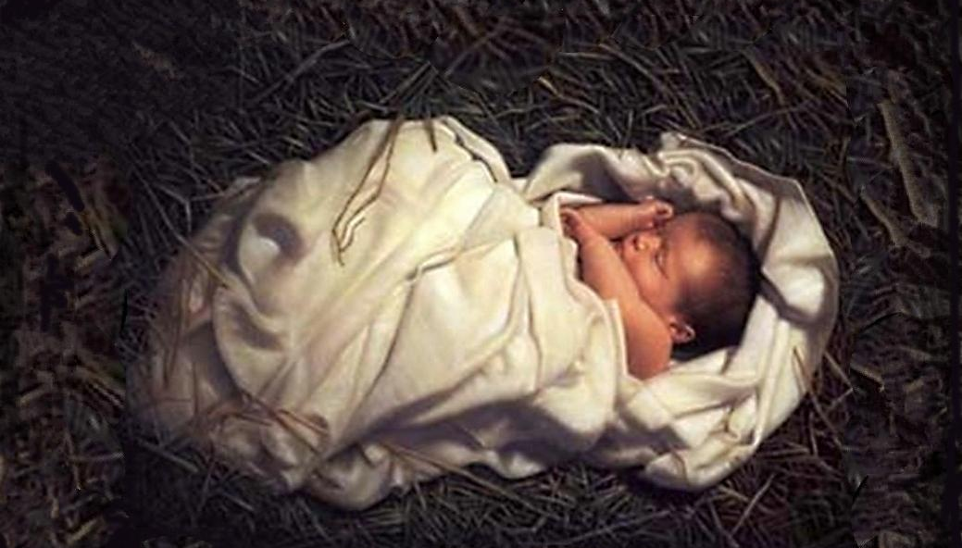
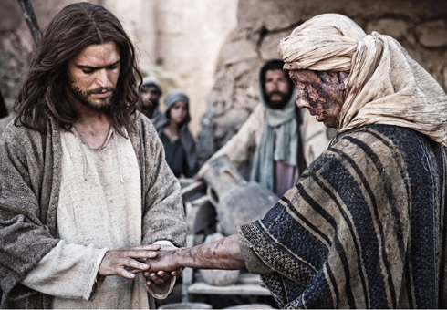
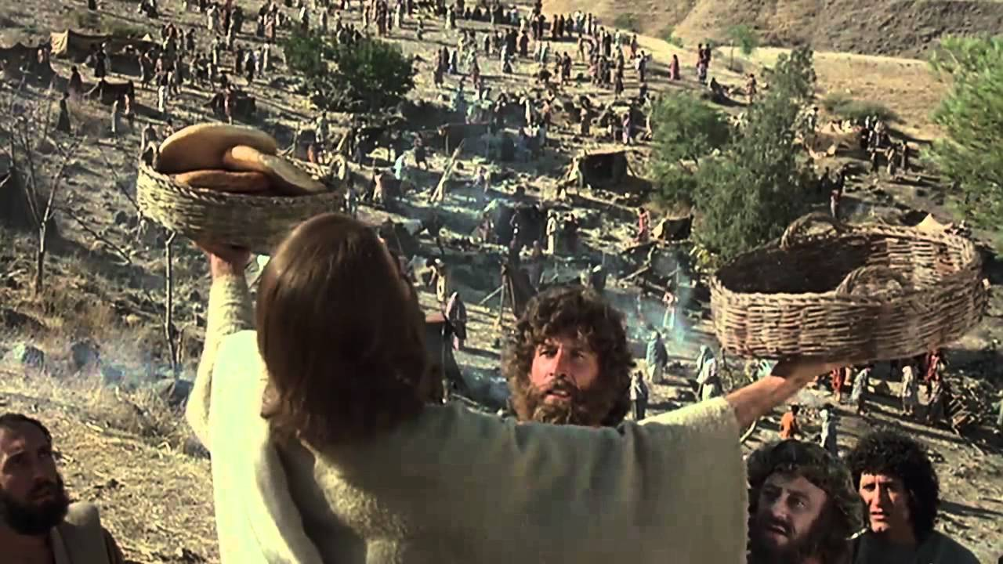
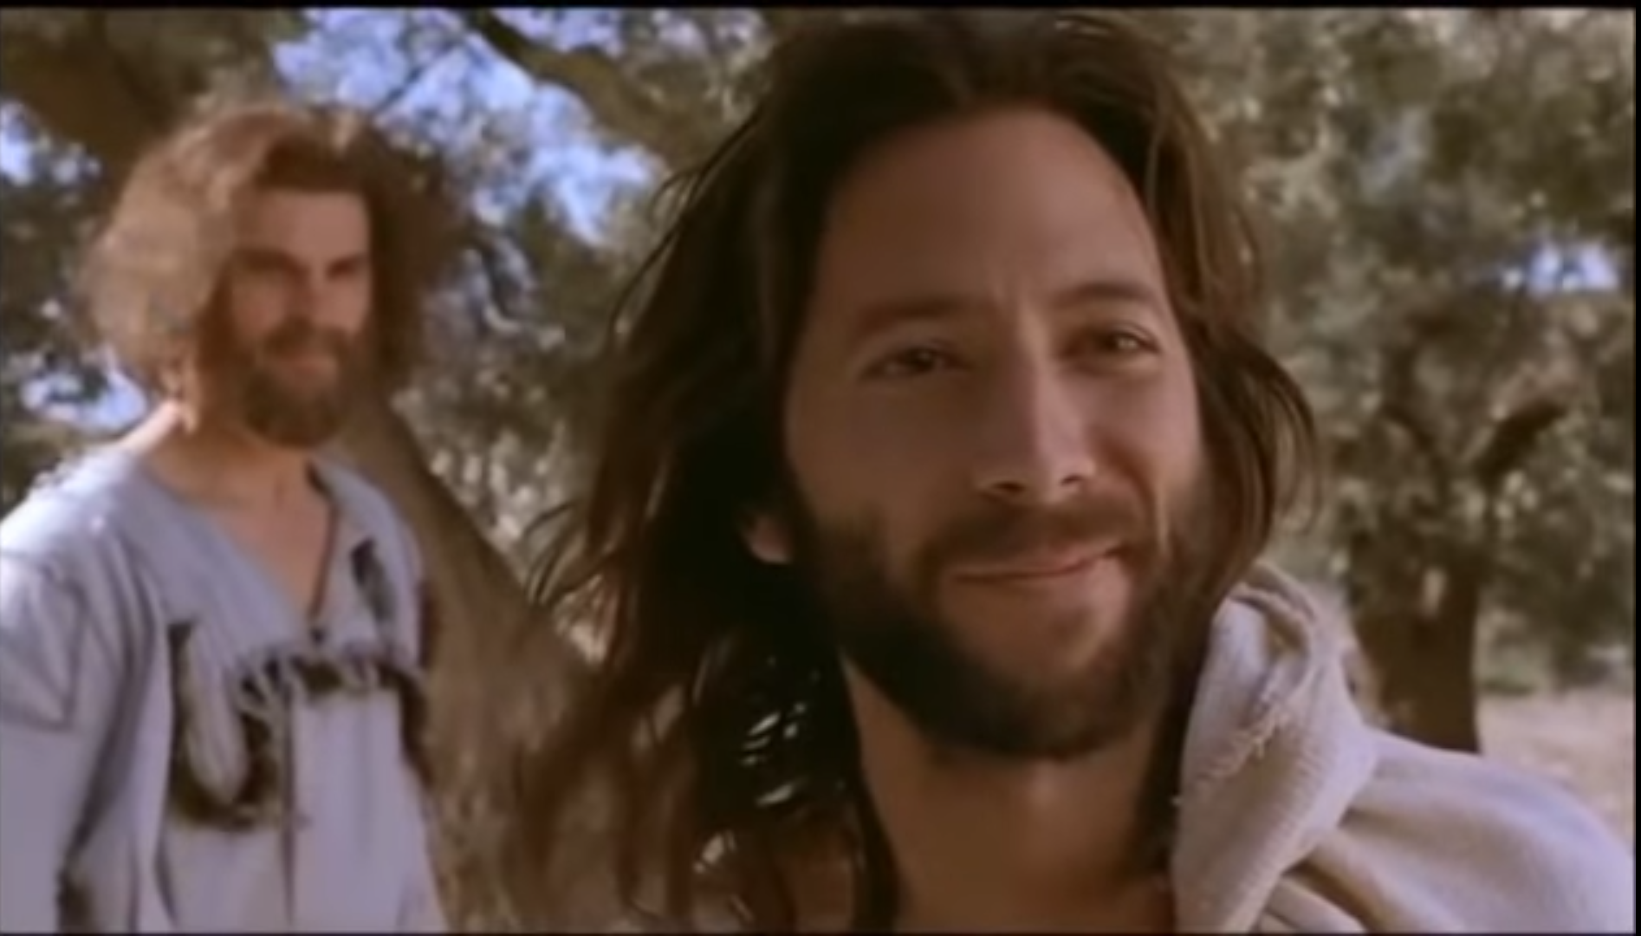
A new command I give you: love one another.
As I have loved you, so you must love one another.
  Acts of Service
  Words of Affirmation
  Quality Time
  Physical Touch
  Gifts

Slide 13
A new command I give you: love one another.
As I have loved you, so you must love one another.
Greater love has no one than this: to lay down one’s life for one’s friends.
John 15:13
This is how we know what love is: Jesus Christ laid down his life for us. And we ought to lay down our lives for our brothers and sisters.
1 John 3:16

Slide 14
A new command I give you: love one another.
As I have loved you, so you must love one another.
By this everyone will know that you are my disciples, if you love one another.
John 13:35
Follow God’s example, therefore, as dearly loved children and live a life of love, just as Christ loved us and gave himself up for us as a fragrant offering and sacrifice to God.
Ephesians 5:1

